Slide 1
Task 1.1 The Role of the Ux Designer
By: Minal Bombatkar

Slide 2


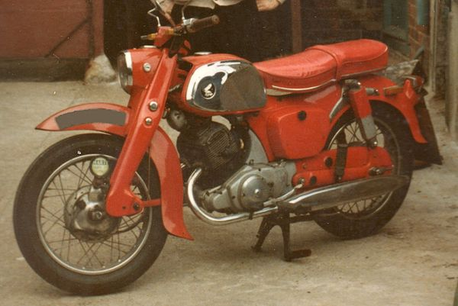
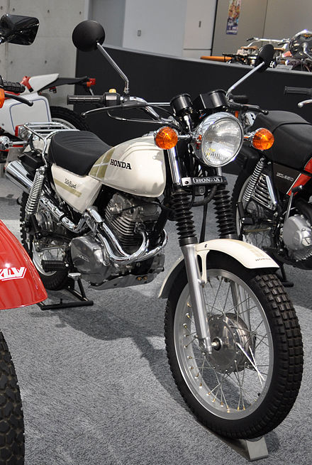
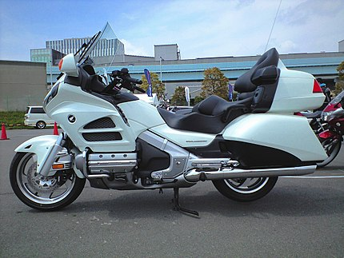
Design evolutions of THE Motorcycles By Honda
1963
1981
2012

Slide 3
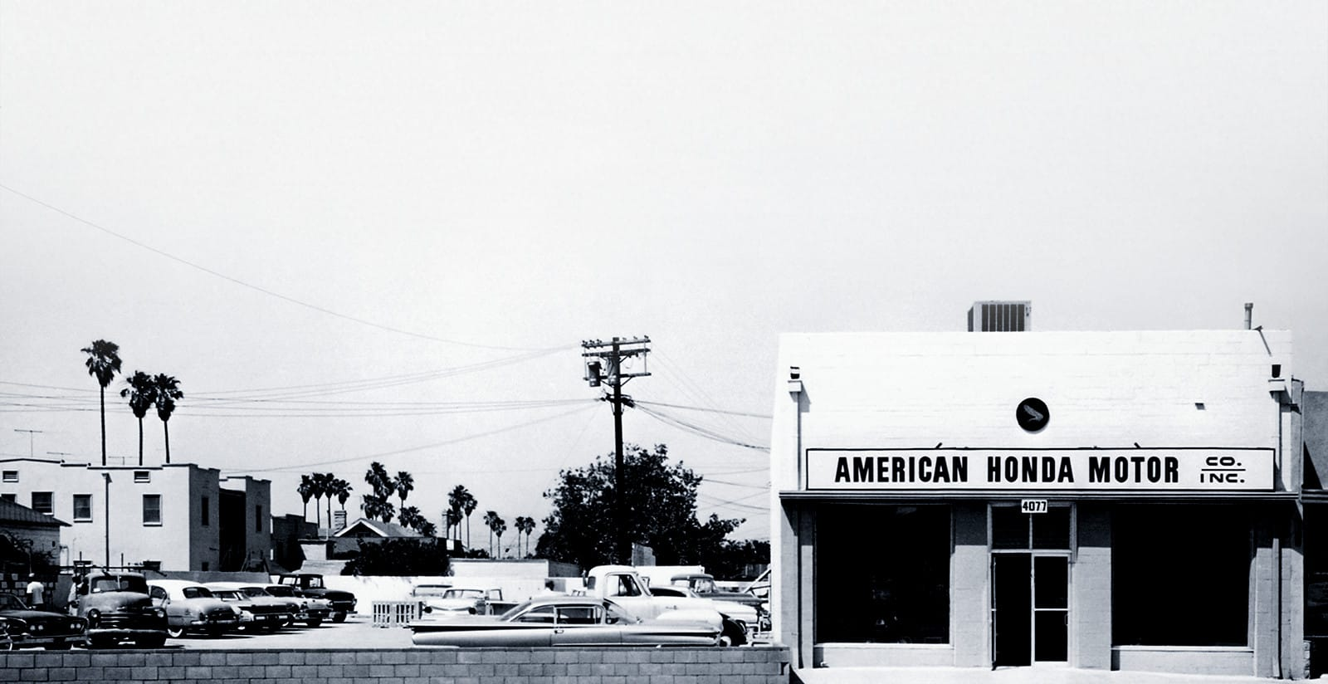
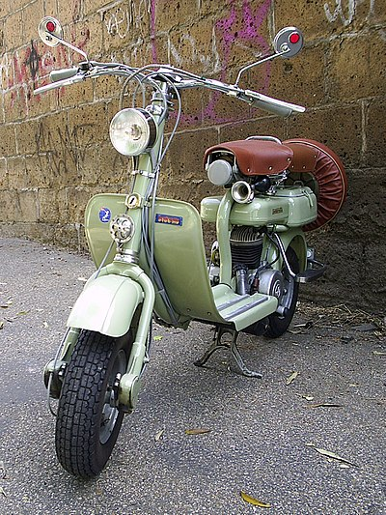
Design evolutions of THE Motorcycles By Honda
Honda Motor Company, Ltd. is a Japanese public multinational corporation. Primarily known as a manufacturer of automobiles, aircraft, motorcycles, and power equipment. Honda has been the world's largest motorcycle
manufacturer since 1959.
Founded in 1948 in Hamamatsu, Japan, Honda opened its first U.S. storefront in Los Angeles, CA, in 1959
In early 1950’s Honda provides bikes series C70 was with 250cc engine and mostly single seat and rack, with clip-on pillion pad
1959

Slide 4
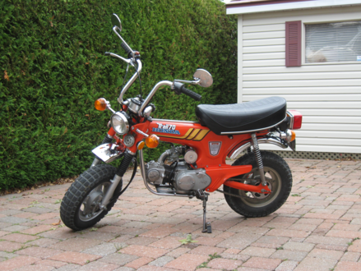
Design evolutions of THE Motorcycles By Honda
By introducing CT250S Silk Road bike Honda enters in trekking" motorcycle field
Its 6-speed transmission was geared as a regular 5-speed plus one extra-low gear
It has slightly more ground clearance and it had single saddle followed by a chrome baggage rack and removable pillion seat
Pre-1977, Honda launched series CA77 and it’s many new series such as CT 200 and many other models with more powerful engine and well-equipped commuter bikes.
It was not particularly sporting, but reliable and comfortable, with a turn of speed.

Slide 5
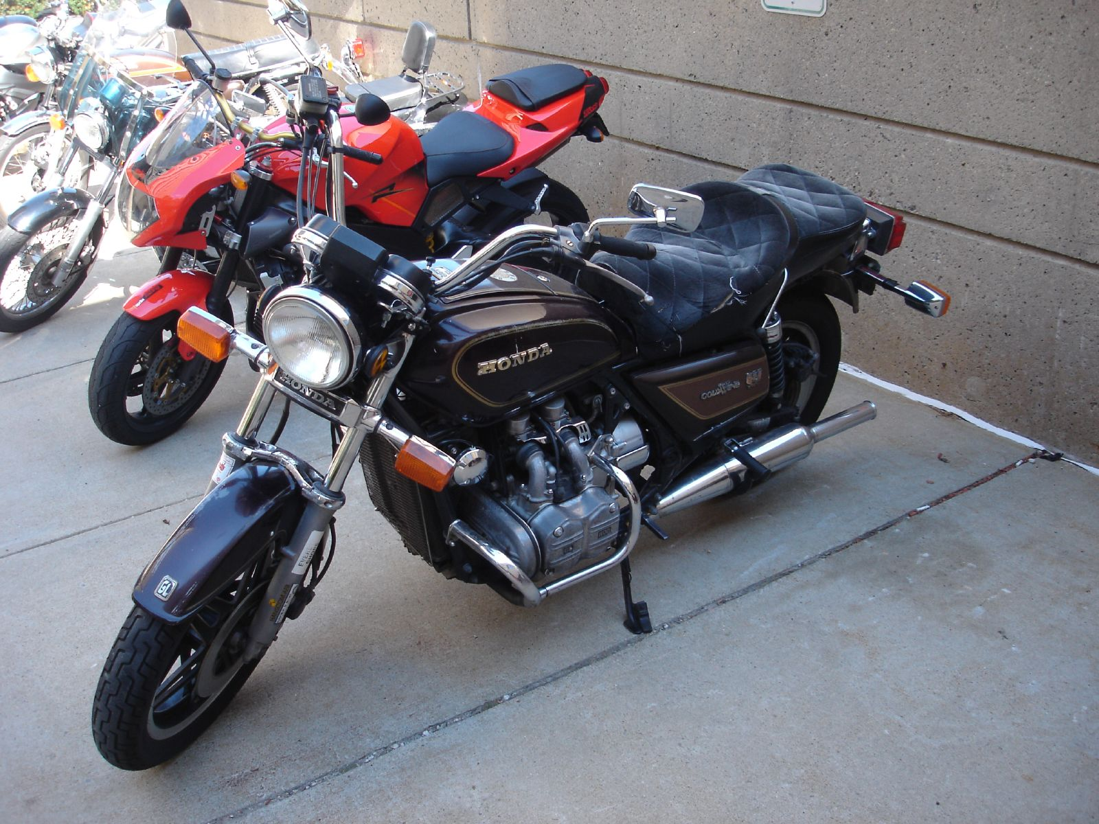
Design evolutions of THE Motorcycles By Honda
With the end of 1990, Honda reached to launched 4th generation Gold Bikes
Honda describes prototype testing as involving sixty developmental stages, and building fifteen different test bikes, including one made from 3 Generation of Gold bikes
This model came with covering drawbacks of previous models. 1995 was the 20th Anniversary of the Gold Wing
Early 1980’s Honda come with GL1000 1st Generation. Honda team finally settled on a layout that became the characteristic Gold Wing
It lacking saddlebags and having no place for luggage, without even a windshield

Slide 6
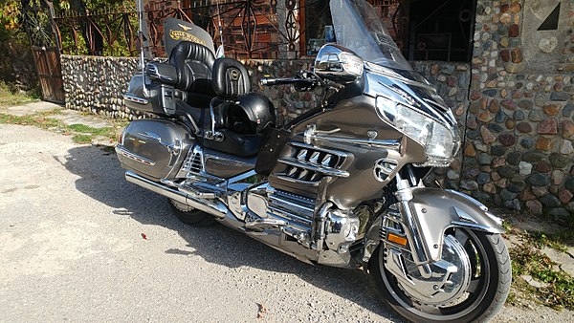
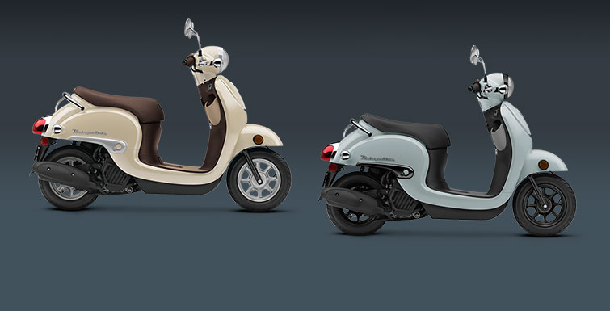
Design evolutions of THE Motorcycles By Honda
In 2018- 2019 Honda offers Metropolitan model, It is suitable for city riders, to solve the parking issues in city
It is Fuel efficient and less emission of carbon, so Eco- friendly bike
There’s a convenience hook that holds grocery bags, an inner rack that has storage space.
5th generation model GL1800 was available for 13 years till 2017
With increased power, aluminium frame, comprising 31 elements resulted in an overall weight decrease
A revised fairing gave better protection to the rider's legs plus a rider "comfort package" comprising saddle heating, heated grips, and adjustable engine-air

Slide 7

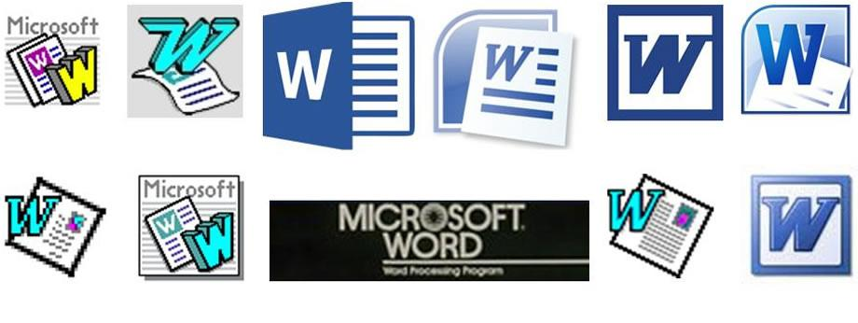
through the ages of THE Microsoft Word
In 1981,the first version of Microsoft Word was developed
Word 1.0 for Windows was followed by Word 2.0 in 1991 and Word 6.0 in 1993
It was renamed to Word 95 and Word 97, Word 2000 and Word for Office XP (to follow Windows commercial names)
With the release of Word 2003, the numbering was again year-based
Windows versions include Word 2007, Word 2010, Word 2013, Word 2016, and most recently, Word for Office 365

Slide 8
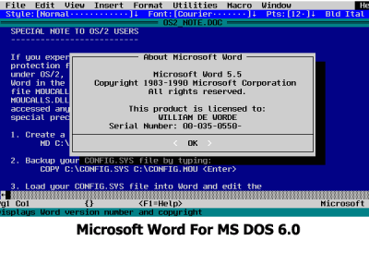
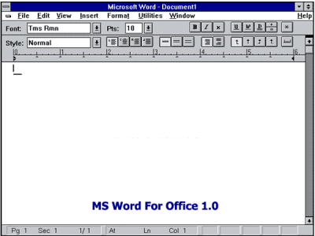
through the ages of THE Microsoft Word
Word for DOS operating system
Word 1.0 to Word 6.0 was developed for DOS operating system
It featured graphics video mode and mouse support
It requires floppy disk to install it

Slide 9
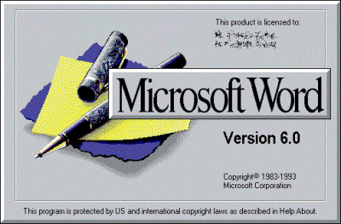
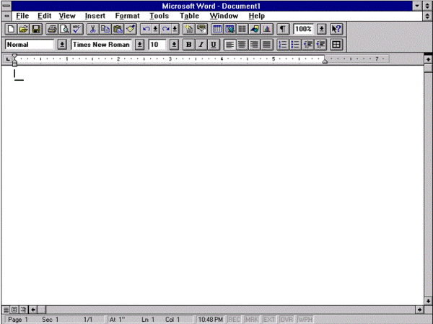
through the ages of THE Microsoft Word
Word for Windows operating system
Word 6.0 was developed for Windows operating system
This time Word developed using a common code methodology for copy prevention and copy protection reason

Slide 10
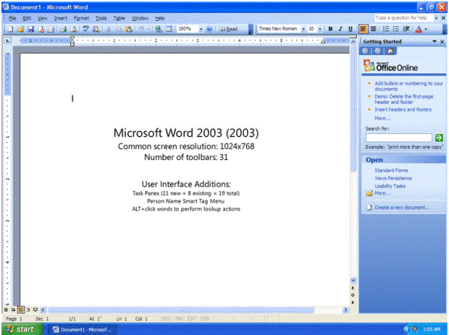
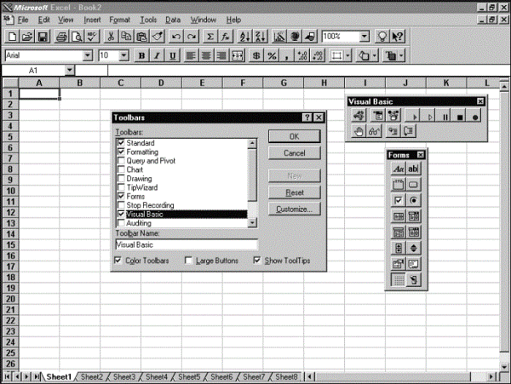
through the ages of THE Microsoft Word
Word 95 or Office 95
Naming convention was changed to match the version numbers of each application software in Office suite! Thus, it was Word 95
Office 2003 or Word 2003
The Most Used MS Office Version Ever:
As plenty of functionality and security features
Blended with Windows XP completely and presented icons and toolbars with the same look as the operating system

Slide 11
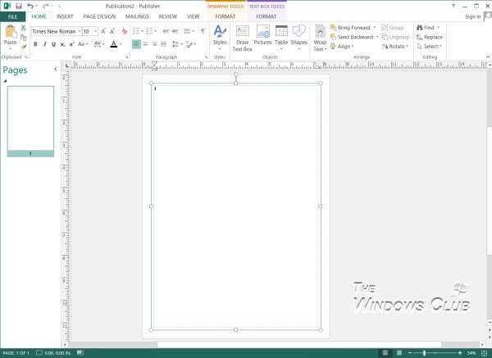
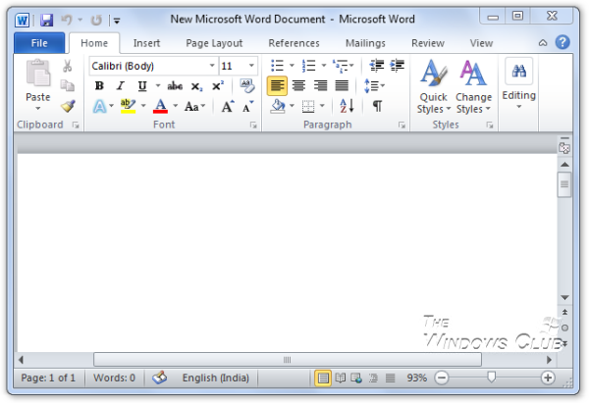
through the ages of THE Microsoft Word
Office 2010/ Word 10
It introduced Office Web Apps
It let people & employees keep in touch and working effectively no matter where they were.
They could use the same applications from their PCs, from a smartphone, or a Web browser.
Office 2013 or Word 13
It comes with cloud integration
The Evolution Of MS Office continues with Office 2013 and makes use of cloud computing

Slide 12
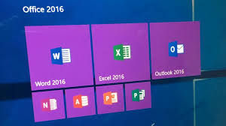

through the ages of THE Microsoft Word
Office 365
Office 365 was introduced in mid-2011,as a replacement to Microsoft’s cloud-based business suite. Since then, it has come a long way and has taken over standalone Office versions in colleges and businesses
It includes the web versions of Word, Excel, PowerPoint, OneNote, and a mail program. It offers unlimited storage on OneDrive
Office 2016 or Word 16
The version is completely optimized for mobile devices and touchscreens.
As such, it does not provide many new features over Office 2013 except for a tighter cloud integration

Slide 13
Resource
https://www.honda.com/about
https://www.bikerandbike.co.uk/history-of-scooters/
https://en.wikipedia.org/wiki/Moped
https://www.google.com/search?q=vespa
https://en.wikipedia.org/wiki/List_of_Honda_motorcycles
https://en.wikipedia.org/wiki/History_of_Microsoft_Word
https://www.atarimagazines.com/startv3n1/microsoftwrite.html?tag=
https://blogs.msdn.microsoft.com/

